Slide 1
Retail approach for EISA AWARD Nokia 7 Plus
20.08.18

Slide 2

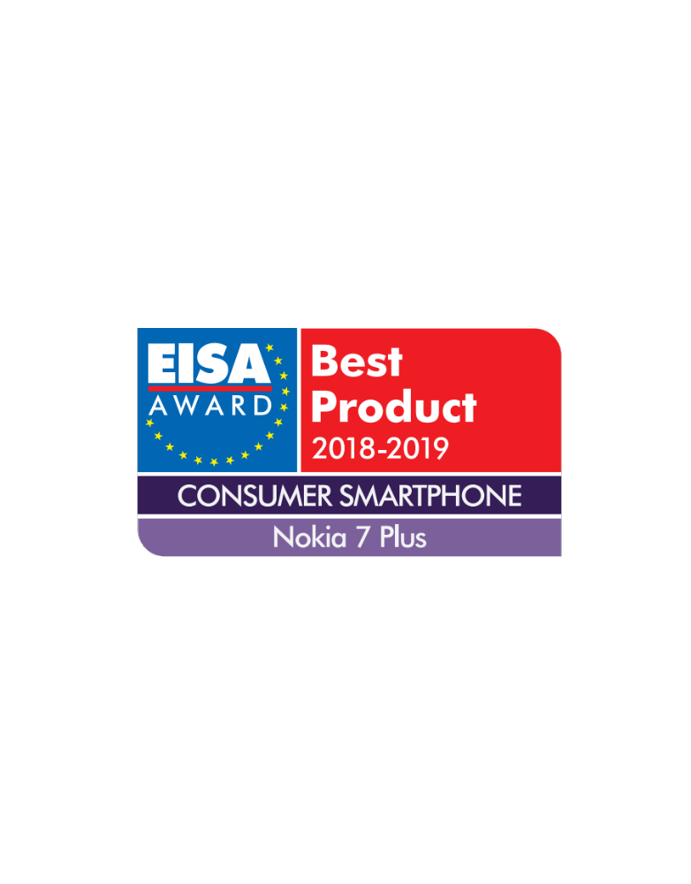
Background:
The Nokia 7 Plus has won the ‘Best Consumer Smartphone 18/19’ award at the EISA (European Imaging and Sound Association) awards
We can talk about this (and use their logo) from the 15th of August
The award will be presented on the 31st of August at the IFA show in Berlin
To make the most of this award win, there are some key considerations and preparations required.

Slide 3
The value of awards:
Our Consumer audience
Our Retailer and trade audience
Awards serve as a mental shortcut – inferring that something is category leading and worthy of their consideration.
It delivers on our reliability positioning to have recognition from independent authorities.
It helps to further rationalize a purchase decision: pre, during and post purchase.
Serves as a catalyst in the ‘return of Nokia’ narrative.
It supports our reliability positioning to have recognition from independent authorities that they know and trust, and subsequently gives them confidence for buying Nokia 7 Plus.
It gives sales staff an objective proof point for prospect conversations.

Slide 4
Where we can make the most of this award:
Pre-purchase
At Purchase
Post Purchase
Social content following award embargo lift and ceremony
Independent reviewers and bloggers – as part of briefing pack for further 7 Plus reviews
Nokia web pages and partner retailer sites through Europe – updates to site copy and logo
In Retailer comms – product cards, wobblers, dummy boxes, strut cards, crowners, etc..
Retail staff comms – notifying front line sales staff
Packaging boxes - stickers to be added to Nokia 7 plus sales packs

Slide 5
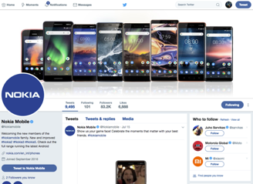
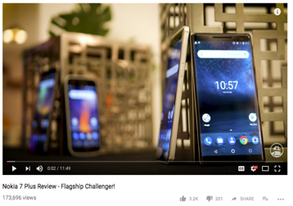
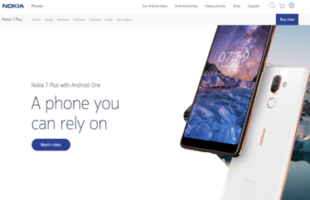
Pre-purchase:
Social channels
Award win shared along with YouTube video from EISA from 16.08. and again on 31.08 during awards show
Reviews and blogs
Included with any press releases / product samples that are shared with press and bloggers from 16.08.
Website
Award win details & logo added to product pages from 01.09.

Slide 6
Retail POS examples for award announcement

Slide 7
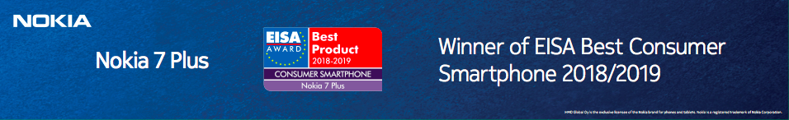
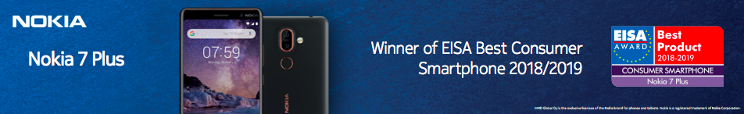
Shelf Barker
Option 1: Award specific version
Option 2: Award with Nokia 7 plus version

Slide 8
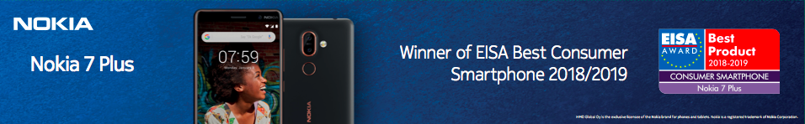
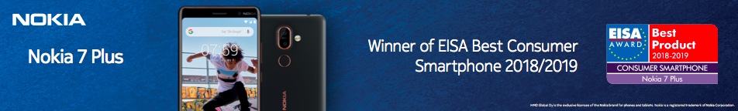
Shelf Barker
Option 3: Award with Nokia 7 plus & lifestyle imagery version

Slide 9
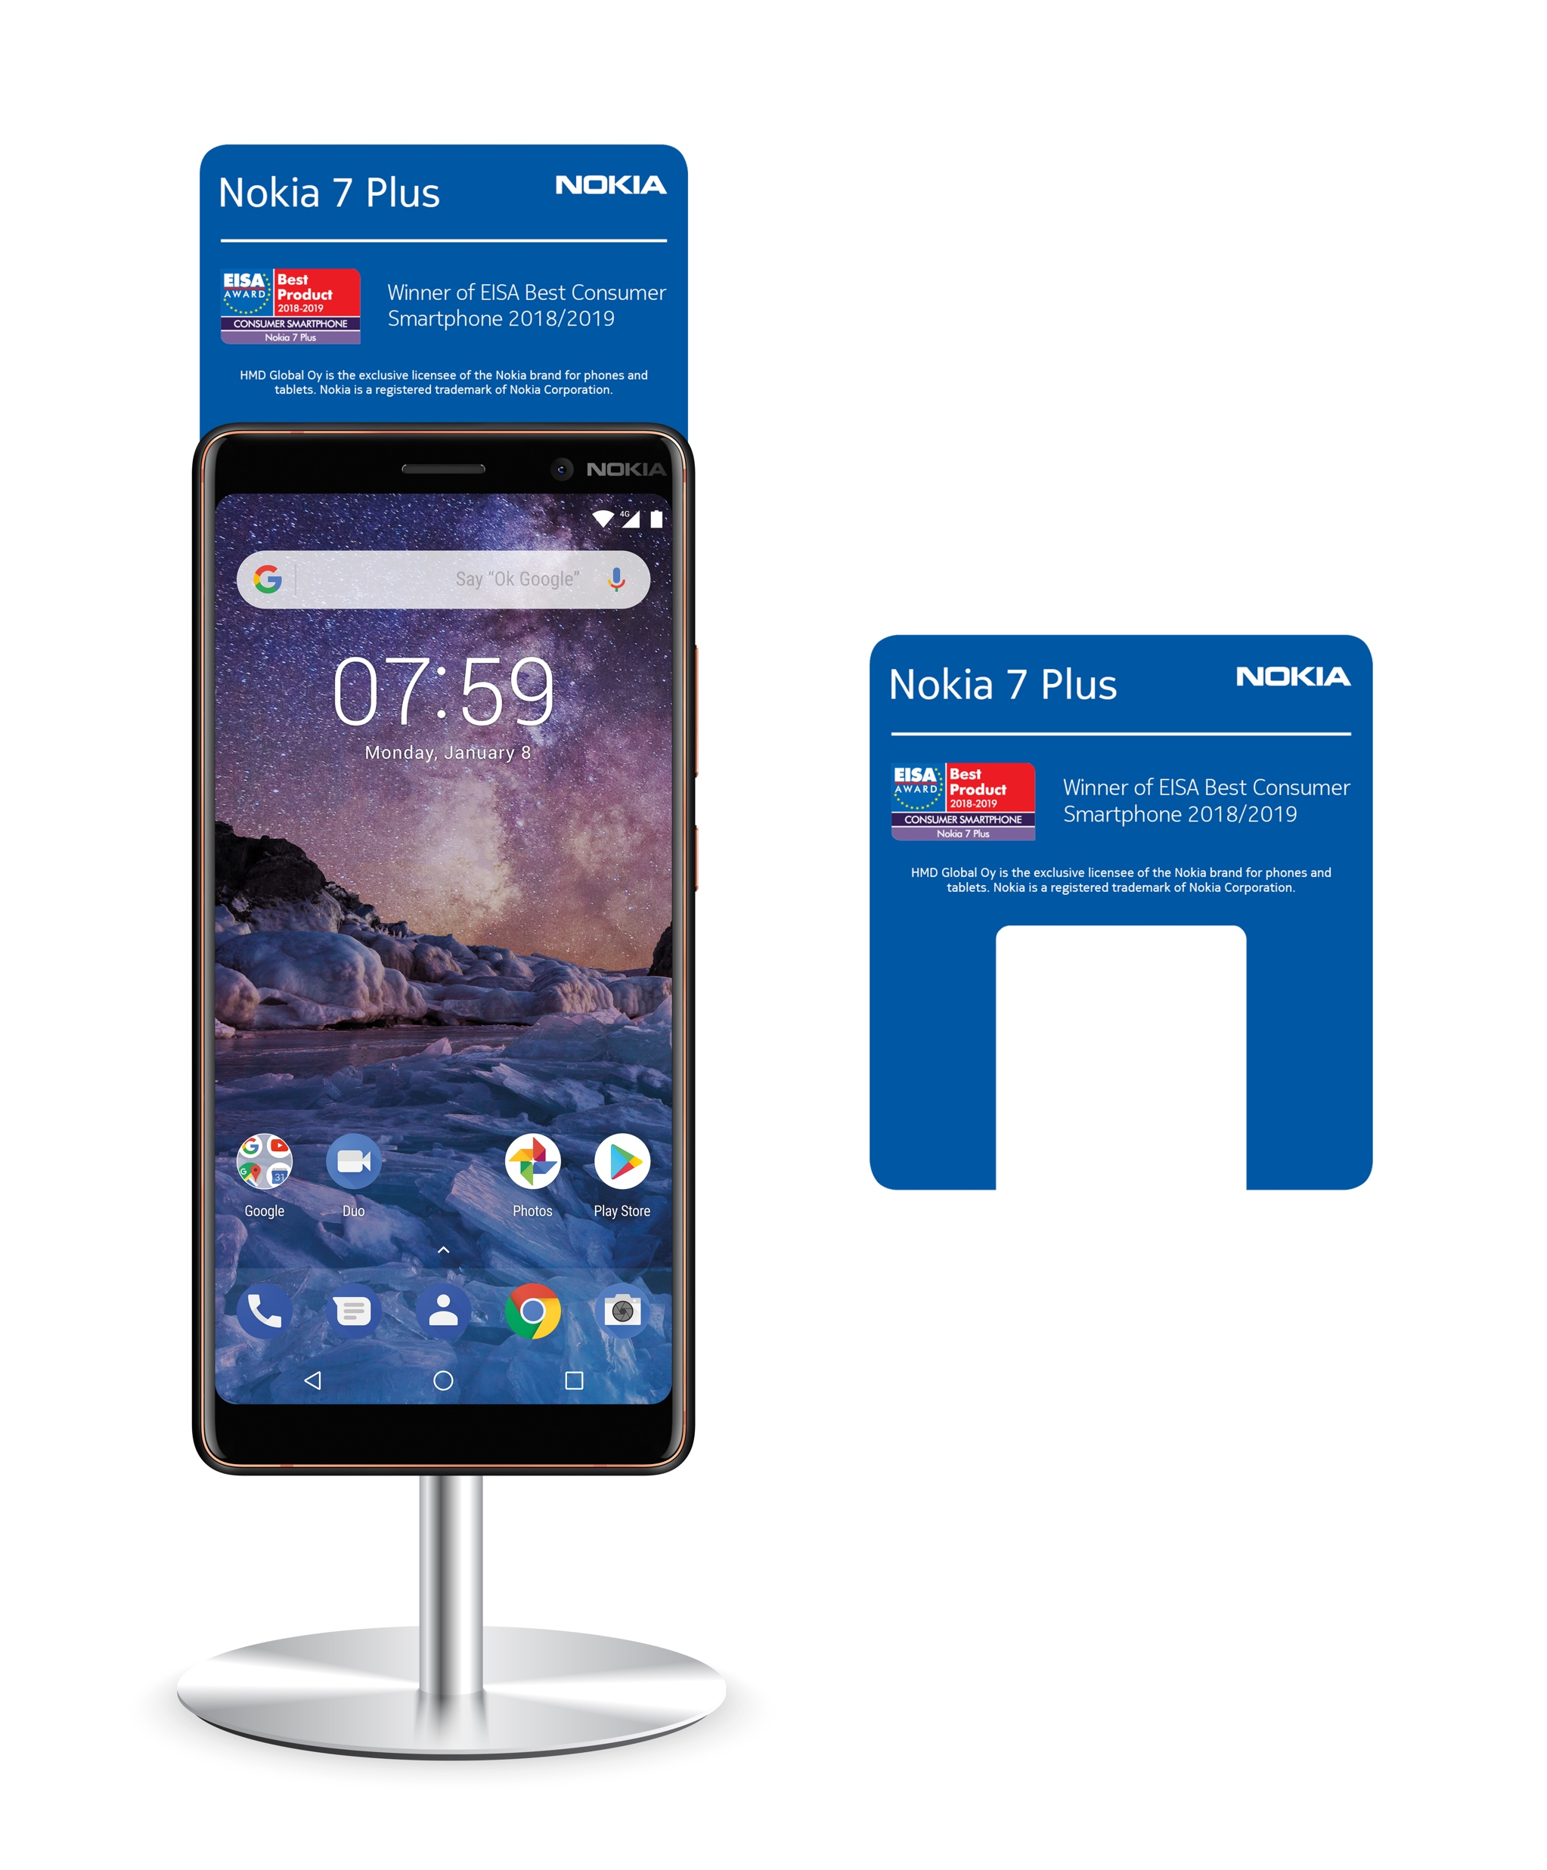
Crowner

Slide 10
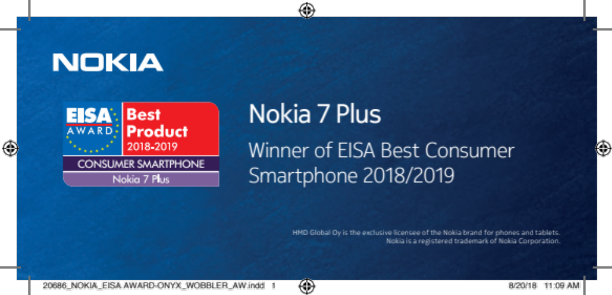
Wobbler

Slide 11
Screen Sticker

Slide 12
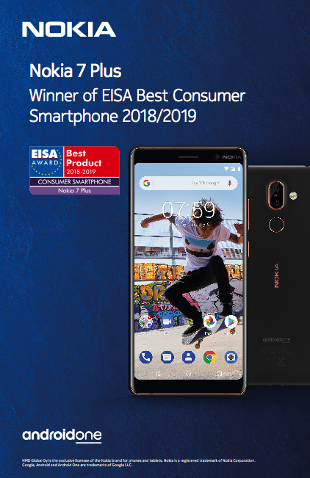
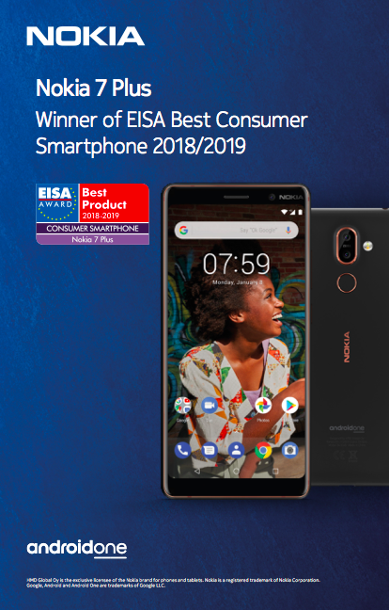
Strut card
Option 1: Inclusion of Nokia 7 Plus & lifestyle imagery

Slide 13
Packaging Box

Slide 14
EISA Award Press Release
Nokia 7 plus wins Consumer Smartphone of the Year at EISA Awards 2018
{CITY, COUNTRY, DD MM YYYY} – HMD Global, the home of Nokia phones, today announces that the Nokia 7 plus has been selected as the Consumer Smartphone of the Year by the Expert Imaging and Sound Association (EISA). The EISA Awards are judged by the world’s largest independent panel comprising over 55 of the most respected specialist magazines and websites. They collectively praised the Nokia 7 plus for its striking design, powerful performance and impressive imaging capabilities, after testing it against stiff competition in one of the most sought-after categories at the awards.
Juho Sarvikas, Chief Product Officer, HMD Global, says:
“The Nokia 7 plus was designed to deliver everything we stand for as a company so we are absolutely thrilled to see that it resonates with industry experts. We strive to create smartphones with the perfect blend of power, photography features and stylish design across all price points. The Nokia 7 plus is the embodiment of our mission to deliver devices that are as beautiful as they are powerful, all at an extraordinary price point. With the Nokia 7 plus now recognised by such an esteemed association as EISA, we are proving that it is possible to deliver world-class style and substance in one powerful device.”
Nokia 7 plus: the flagship hero for everyone
Made for creators to deliver stunning content, the Nokia 7 plus is a true hero in the Nokia smartphone range. Combining innovative optical hardware and imaging algorithms, the Nokia 7 plus captures moments into photos that are true to life. Dual rear sensors with ZEISS optics combine an ultra-sensitive 12MP wide-angle primary camera for impressive performance in both low-light and extra bright conditions and a secondary 13MP sensor that delivers 2x optical zoom for the moments when you wish you were closer. The Nokia 7 plus boasts Pro Camera mode which lets you take pictures like a pro by giving you quick and easy manual control over advanced camera settings like white balance, focus, ISO, shutter speed and exposure.
With its impressive 16MP front-facing camera with ZEISS optics, the Nokia 7 plus adapts to low light conditions by increasing light sensitivity to guarantee picture-perfect selfies. Enhanced Dual-Sight harnesses the front and back cameras simultaneously to capture the ultimate #Bothie and keep it safe with unlimited photo and video uploads to Google Photos. Three microphones capture immersive 360° Nokia spatial audio to match your 4K video, helping transport your audience to the centre of the action and creating content worthy of the big screen.
.
Optimised for maximum performance at all times, it delivers an amazing 2-day battery life. With its gently curved back and slim edges, the Nokia 7 plus gives you a big-screen experience in a comfortable, stylish package while the vivid 6-inch 18:9 Full HD+ display makes the Nokia 7 plus perfect for browsing, social media consumption, gaming and entertainment.
Design, innovation and technology
The EISA Awards see experts from across the globe voting in categories including Photography, Hi-fi Home Theatre and Mobile devices. All products nominated for an EISA Award undergo a comprehensive multi-step judging process including intensive tests to rate their technology, design and innovation. Products that pass these rigorous tests are shortlisted in their respective categories which is proof of their world-class credentials. Having excelled across the board, the Nokia 7 plus was voted as the leading consumer smartphone in the Mobile Device category and will receive the EISA Award for 2018-19.
A list of all award winners is available on the EISA website. The winning products will be presented during IFA, the world’s largest consumer electronics fair, held in Berlin in the period 31 August to 5 September.
- ENDS -
For further information, please contact:
HMD Press Office: press@hmdglobal.com
About HMD Global
Headquartered in Espoo, Finland, HMD Global Oy is the home of Nokia phones. HMD designs and markets a range of smartphones and feature phones targeted at a range of consumers and price points. With a commitment to innovation and quality, HMD is the proud exclusive licensee of the Nokia brand for phones and tablets. For further information, see www.hmdglobal.com.
Nokia is a registered trademark of Nokia Corporation. Android, Google and other marks are trademarks of Google LLC; Oreo is a trademark of Mondelez International, Inc. group. Qualcomm and Snapdragon are trademarks of Qualcomm Incorporated, registered in the United States and other countries. Qualcomm Snapdragon is a product of Qualcomm Technologies, Inc. and/or its subsidiaries.

Slide 15
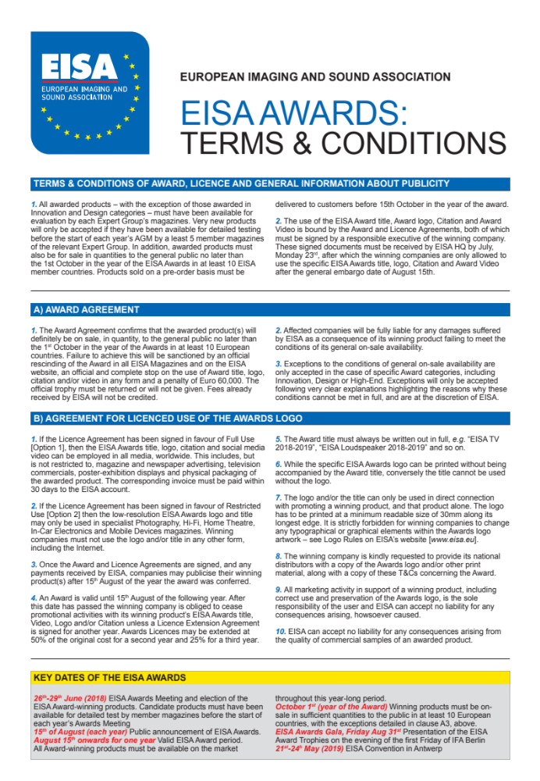
Terms and Conditions
Key Contacts - CEE Team
tomislav.himbele@hmdglobal.com
hayley.dodd@hmdglobal.com

Slide 16
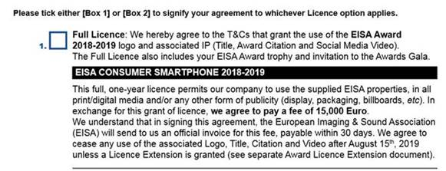
Logo Usage Rights

Slide 17
Map Links
Crowner: https://asset.hmdglobal.com/media/?mediaId=4749799C-6EE2-45CB-86873A3A2FB0EF15
Wobbler: https://asset.hmdglobal.com/media/?mediaId=B9B1DCF6-5394-44BD-8CEB74628BE42C97
Screen sticker: https://asset.hmdglobal.com/media/?mediaId=CA9B4032-5B7A-404A-9612CC42AB5E4626
Shelf barker: https://asset.hmdglobal.com/media/?mediaId=0775D39B-F4B8-497D-ABD1BB9BD5A81A5B
Strut Card: https://asset.hmdglobal.com/media/?mediaId=3D40FB99-20D9-4216-AFC1E7387DBFA23C
Logo: https://asset.hmdglobal.com/media/?mediaId=5947EA85-3698-47A7-8611EEDE1F069C00

