Slide 1
Samsung
Galaxy A7 | A9
Toolkit
20 September 2018

Slide 2
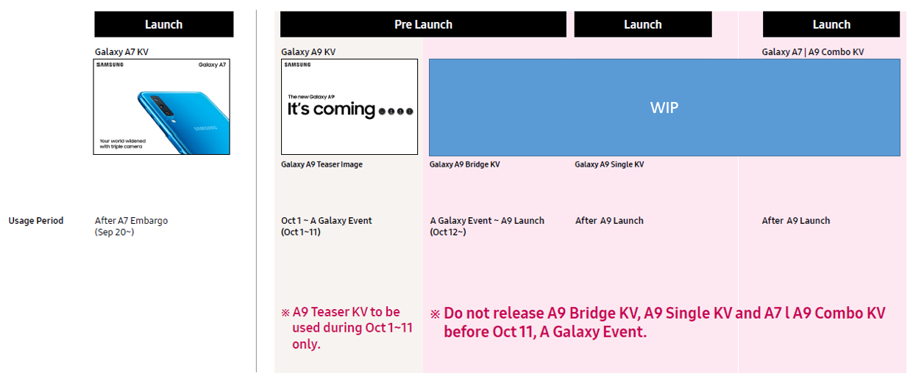
Key visuals overview

Slide 3
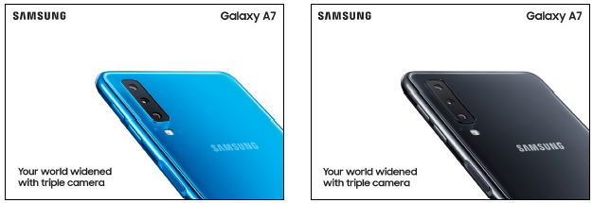
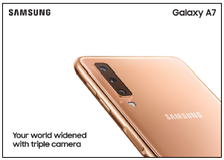
A7 Key Visuals
A7 Single KV option is available for blue, black and gold colors.
Please use in Digital / Print / OOH / etc.
Please use Blue Key visual as the primary.
KV source files are available here: https://drive.google.com/drive/folders/1vL4BAIbHIwVV9wii6swr_G0wlGb8tQva?usp=sharing
Localized KV versions WON’T be provided. Please ask Partners to implement localized texts on KV.
Galaxy A7 Key Visual slogan translations | ENG | LV | LT | EE | RU
 | Your world widened with triple camera | Pasaule kļūst plašāka ar trīs objektīvu kameru | Platesnis pasaulio vaizdas su triguba kamera | Avarda oma maailma kolme kaameraga | Мир становится шире благодаря камере с тремя объективами

Slide 4
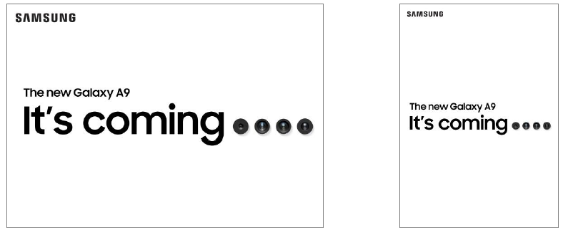
A9 Teaser Visual
A9 Teaser visual is to generate buzz and attract consumer attention on ‘4-camera’ from early stage.
Please use in Digital / Print / OOH / etc.
KV source files are available here: https://drive.google.com/drive/folders/1vL4BAIbHIwVV9wii6swr_G0wlGb8tQva?usp=sharing
Localized KV versions WON’T be provided. Please ask Partners to implement localized texts on KV.
 | ENG | LV | LT | EE | RU
Galaxy A9 Teaser Visual | The new Galaxy A9 It's coming | Jaunais Galaxy A9 Drīzumā | Naujasis Galaxy A9 Atkeliauja | Uus Galaxy A9 Peagi kohal | Новый Galaxy A9 Уже скоро

Slide 5


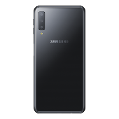


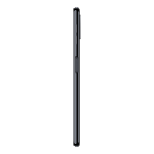





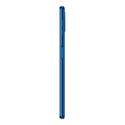






Galaxy A7 Product pictures
Pictures source files are available here: https://drive.google.com/drive/folders/1vL4BAIbHIwVV9wii6swr_G0wlGb8tQva?usp=sharing
Black
Blue
Gold
※ A9 basic product images to be released on Oct. 17

Slide 6
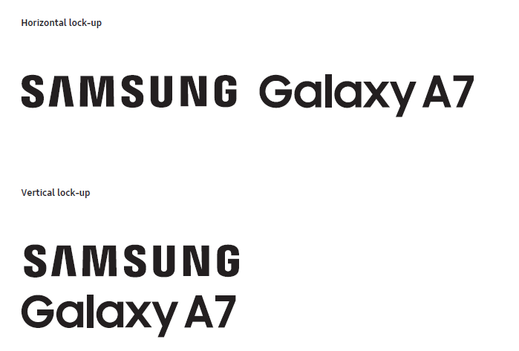
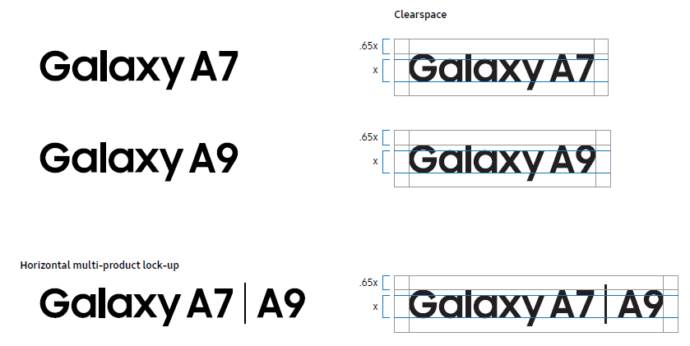
Logos

Slide 7
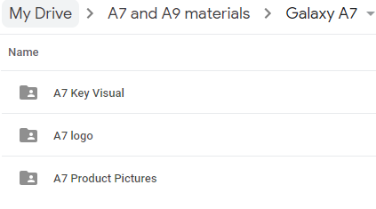
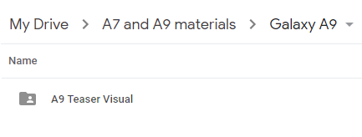
Key visuals source files
Galaxy A7 & A9 materials source files:
https://drive.google.com/drive/folders/1vL4BAIbHIwVV9wii6swr_G0wlGb8tQva?usp=sharing
Galaxy A7 folder:
  Key Visuals (ENG), horizontal, vertical
  Product Pictures
  Logo
Galaxy A9 folder:
  Teaser Visual (ENG)

